Slide 1
Child Friendly Complaints | Launch Event
Rosemary Agnew and Joshua Barnham

Slide 2
Welcome!
Thank you all for coming
We will be recording today’s event
We will open the chat function for questions towards the end
Recording will stop when Q&A starts and cameras and mics are on

Slide 3
About the UNCRC
Stakeholder reflections
Overview of how to be more child friendly in responding to complaints
Q&A
Close

Slide 4
The UNCRC

Slide 5
But first, let’s hear from other stakeholders

Slide 6
Young people

Slide 7
Advocacy organisations

Slide 8
Over to Josh …

Slide 9
Project Aim
Co-design and implement a public sector complaints service that meets children’s rights and needs, working in co-operation with children and young people, public bodies and wider stakeholders

Slide 10
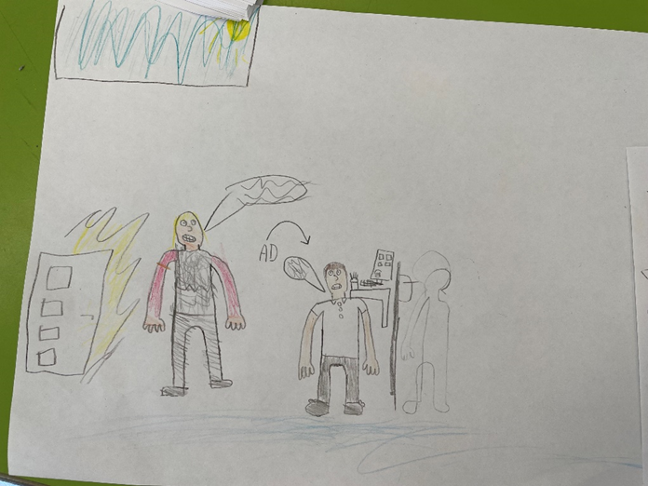
The really fun bit; co-design

Slide 12
An example …
Angela is 10
She tells mum someone at school called her a bad name
Angela said her teacher told her to ignore it
Mum asks the teacher about it
Teacher explained what happened
Same happened next week so mum emailed the headteacher to complain

Slide 13
Questions

Slide 14
Contact
Child friendly complaint specific queries contact SPSO on
ISE-CSA@spso.gov.scot
Other organisations who may be able to help about children’s rights are

