Slide 1
SPSO Workshop: Tools for supporting respectful engagement
Notes:
Welcome

Slide 2


Introduction – 5 mins
Case study discussions – 20 mins
Case study feedback – 20 mins
Respectful engagement tools – 15 mins
Wrap up – 5 mins
Timings

Slide 3
Case study
Discussion 20 minutes

Slide 4
Case study feedback
Discussion 20 minutes

Slide 5

Contact Point 1
I’ve just listened to your introduction message saying people aren’t allowed to harass you. ​
What’s wrong with people these days, you are working with the public and people get angry, get over it. ​
​
I don’t need told you don’t accept harassment before I even speak to anyone. ​
I’ve got a demand of you too, I want a reasonable adjustment, and you need to make one, OK.​
And a reminder, you work for me, I’m your boss, you are a public servant.
What do you feel requires to be addressed here and what tools could you use?
How would you respond to the points in this statement?

Slide 6
SPSO suggestions
Reasonable adjustment request
“To help us understand what access needs you have, could you please tell me why you require a reasonable adjustment and what adjustment you would like us to consider?”
Addressing Jack's tone
“Can I suggest we pause for a second, I really want to offer you the best advice I can, can we please continue this conversation in a respectful manner.”
By asking this question it helps us understand the access needs for people with differing communication requirements.
We may be able to draw upon past experience and suggest other ways suggest other ways to make our service accessible.
This response to a reasonable adjustment request has been approved by the Equality Advice and Support Service.

Slide 7
Contact Point 2
You receive an email from Jack stating:
I have filled in your complaint form you should have this now.
I have just got a message saying it will be 5 days before you get back in touch. Get a Manager to get back to me immediately.
Is this some kind of joke, this matter is urgent, you are corrupt, you are meant to be working for me so get on with it RIGHT NOW.
What do you feel requires to be addressed here and what tools could you use?
How would you respond to the points in this statement?

Slide 8
SPSO suggestions
Thank you for your email.
Your enquiry does not require to be responded to by a Manager. I can advise you on the progress of your complaint.
I can confirm that we have received your complaint and plan to assess the information you have provided to us. It may take up to 5 days for us to consider your submission. We will back in touch with you to update you on how your complaint will progress as soon as possible.
When we spoke yesterday, I asked that communication between us remains respectful.
We are committed to offering a high-quality service and we believe that complainants have a right to be heard, understood and respected. I note your comment about our organisation being a corrupt organisation. I would like to make you aware that we consider unsubstantiated allegations to be abusive behaviour.
In light of this, I would draw your attention to our engagement policy:
https://www.spso.org.uk/engagement-policy. (example)
This policy explains how we address unacceptable actions towards our staff and sets out the kinds of actions and behaviour that may have a negative effect and what we can do if this occurs.
To be clear, we do not want to have to apply this policy, or put in place any restrictions. We are just asking you to keep it in mind should you need to contact our office again.
Address the aggression, unsubstantiated allegation and demand that a Manager deals with the matter.
Introduce the engagement policy into the discussion:

Slide 9
Contact Point 3
OK, you’ve had 24 hours and you’ve done nothing.
I am coming down to your office myself at noon, you haven’t seen anything yet in terms of the aggression that you have accused me of but you sure will.
What do you feel requires to be addressed here and what tools could you use?
How would you respond to the points in this statement?

Slide 10
SPSO suggestions
Address the threat immediately
“We do not tolerate serious threats and what you’ve just said to me, I consider to be a serious threat. I require to take action on any serious threats made to this office by notifying my Manager a threat has been made and possibly the police.”
Response approved by Police Scotland

Slide 11
Respectful Engagement
Tools and Techniques
15 minutes

Slide 12
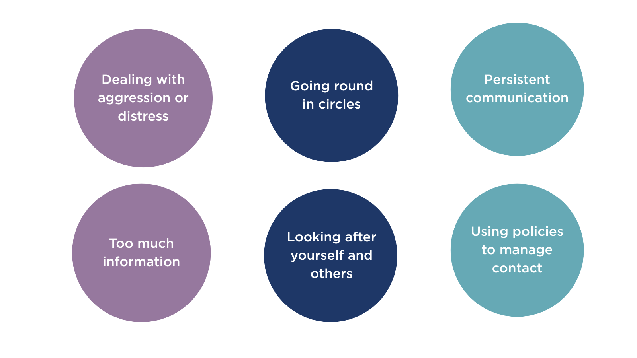

Slide 13
Dealing with Aggression or Distress
Acknowledge
I can hear this situation is making you very angry
I understand why that would be upsetting / I agree that would be frustrating
I understand your position and why you feel strongly about this
Refocus
Let’s look at what we can do today...
We can help by..
Boundaries
We may need to take a break because this conversation is becoming difficult
We can’t solve the problem/take this forward while this discussion is distressing you so much.
This conversation is becoming unhelpful. If the shouting doesn’t stop, I’m going to have to end this call.
I will end this call as it is not possible to continue, I have explained I would need to do so if the shouting doesn’t stop and it is continuing.

Slide 14
Going round in circles
Acknowledge
We are now going round in circles.
The conversation isn’t productive/ we aren’t making any progress
We are covering the same ground
Refocus
Let me clarify / Let me summarise / Let me recap
I would like to ask you some questions
Let’s focus on how we can take this forward
Boundaries
We are now repeating ourselves again and that’s not moving things forward. I need to now go and ... note what we’ve agreed / send you information / make enquiries
It would be really helpful if you could put this in writing for us. We don’t need all the detail, and you may find summarising or using bullet points helps you to highlight the key points you want us to consider.

Slide 15
Persistent Communication
Acknowledge
I know how important this matter is to you.
Refocus
I understand that you have also spoken to my colleagues about this matter recently. We have all given you the same advice, and that advice still stands.
Boundaries
Can we agree that if you have any further questions that you contact me directly as I am dealing with this matter.
I do need some time and space now to progress my consideration of the complaint. If I need anything further from you, I will be in touch.
Top tip: discuss with colleagues to identify persistent communication and to ensure a consistent approach.

Slide 16
Too much information
Telephone Contact
Let’s focus on some of the key points. I would like to ask you some quick questions that you can answer yes or no to help us concentrate on those.
I would like to help us move forward by concentrating on areas where we can help. I know this is part of a bigger picture and I will make sure I ask questions that help us get all the information we need.
Email Contact
We have received in excess of ** emails from you.
Please do not send any further emails today. It is taking time away from considering and responding to existing emails that we already have from you. We do not intend to respond to the emails that you have sent to this email address individually.
Please find our Engagement Policy which explains how we will interact with people. We would like to draw your attention to the section on Levels of Contact.
We feel that the level of contact from yourself via email has become unacceptable and we are requesting that you refrain from sending excessive amounts of emails to our office. If you continue to do so we will look to restrict direct email contact with our office.

Slide 17
Looking after yourself and others
Communication is Key
Know what support is available – mangers for escalation, colleagues for debrief
Communicate with colleagues to contain and manage incidents
Share experiences and learning at team meetings
Resources and Tools
Developing guidance to support implementation of engagement policy
Technology – alerts on case management system, call recording for reflection
Wellbeing
Foster a supportive culture where people have autonomy to make a judgement on what they need - taking a break, getting fresh air, doing a different task for the rest of the day

Slide 18
Using policies to manage contact
Staff should be empowered to end a call if it is making them distressed or uncomfortable.
Equally, if communication is having a long-term, negative impact on staff or on the management of workload, then most organisations will have a policy to manage or restrict contact.
Our top tips:
FAMILIARISE: before implementing your policies, make sure you are familiar with them.
ADVISE: give due warning where appropriate.
RECORD: ensure you record your decision.
REVIEW: review the position at the appropriate level and intervals.
SPSO Respectful Engagement Policy

Slide 19

Thank you
Stay in touch
Email ise-training@spso.gov.scot

